Slide 1
Weekly Meal
Planner & Grocery
Generator
Plan smarter. Shop efficiently. Waste less.
P. Renu Sree
M. Meghana Sruthi
2620030098
2620030293
01 / 12

Slide 2
01 — PROJECT OVERVIEW
Abstract
A simple Java application that turns weekly meal choices into an organized shopping plan.
Users can plan breakfast, lunch, dinner and snacks for each day of the week. Once meals are selected, the system gathers the ingredients into one grocery list, helping users shop with a clearer plan.
The project aims to reduce planning time, avoid unnecessary purchases, minimize food waste and encourage healthy eating. It also demonstrates Java fundamentals including classes, objects, methods, arrays, loops, conditionals, collections and file handling.
THE INPUT
Meal choices organized by day and meal type.
THE OUTPUT
A weekly schedule plus a consolidated grocery list.
KEYWORDS
Meal planning
Java
Ingredient tracking
Automation
File handling
Collections
02 / 12

Slide 3
02 — PROBLEM STATEMENT
Understanding the Problem
Manual meal planning creates small tasks that add up.
01 PLAN
02 CALCULATE
03 SHOP
Choose meals for seven days and multiple meal categories.
Collect ingredients and combine repeated items and quantities.
Create a clear list to help avoid forgotten or unnecessary purchases.
PROJECT OBJECTIVE
Automate weekly scheduling and grocery-list generation through a simple, user-friendly Java program.
Less effort
Fewer duplicates
Better organization
03 / 12

Slide 4
CO1 · MODULE 1 — COMPUTATIONAL THINKING & JAVA FOUNDATIONS
CO1
From Problem to Program
Build a solution by breaking the task into logical, testable steps.
THINK
DESIGN
CODE
Identify inputs (meal choices), processing (ingredient aggregation) and outputs (plan and list).
Represent the steps with an algorithm or flowchart before writing code.
Use Java structure, variables, data types, operators and Scanner for console input.
FOUNDATION TOOLKIT
Primitive types
Variables & constants
Operators
Expressions
Console I/O
Outcome: a clear algorithm becomes a structured Java program.
04 / 12

Slide 5
CO2 · MODULE 2 — CONTROL FLOW
CO2
Control Flow: Selection & Iteration
The program must make decisions and repeat work across days, meals and ingredients.
SELECTION
LOOPS
SAFE FLOW
if, if–else and switch can handle menu options such as add, remove, view or generate.
for, while and do–while can process each day and each selected meal.
Use break and continue intentionally; check loop conditions to avoid infinite loops.
EXAMPLE
For each day → visit each meal → read its ingredients → update the grocery list
Outcome: predictable navigation and consistent processing.
05 / 12

Slide 6
CO3 · MODULE 3 — DECOMPOSITION AND DATA PROCESSING
CO3
Methods, Recursion & Arrays
REUSABLE METHODS
ARRAY PROCESSING
PARAMETERS & RETURNS
Separate operations into methods such as addMeal(), removeMeal() and generateGroceryList().
Traverse entries to search, count, sum ingredient quantities and calculate averages.
Pass meal data into methods and return results for display or further processing.
GROCERY-LIST PIPELINE
01
Read meals
→
02
Visit ingredients
→
03
Combine quantities
→
04
Show list
Outcome: smaller methods make the project easier to test and maintain.
06 / 12

Slide 7
CO4 · MODULE 4 — MODELLING AND ROBUST CODE
CO4
Object-Oriented Design & Exceptions
Model the project using objects with clear data and responsibilities.
MEAL / RECIPE
WEEKLY PLAN
GROCERY ITEM
May store a name, meal type and ingredient details, with methods to view or update the recipe.
Organizes selected meals by day and category; encapsulation protects internal data.
Represents an ingredient and the combined quantity needed for shopping.
DESIGN TOOLS
Classes • constructors • private fields • getters/setters • inheritance • interfaces
Exception handling with try–catch and try-with-resources can help handle invalid input or missing files.
07 / 12

Slide 8
CO5 · MODULE 5 — TEXT PROCESSING AND PERSISTENCE
CO5
Strings, Algorithms & File I/O
STRING HANDLING
SORT & SEARCH
FILE OPERATIONS
Validate meal names, trim extra spaces, search text and compare values with equals().
Use Java library tools to sort grocery items and search for a recipe or ingredient.
Read or save meal plans with Path, Files and buffered readers/writers.
WHY IT MATTERS
String methods help process ingredient names and menu choices.
Sorting keeps grocery items easier to scan; searching helps locate entries.
File I/O can preserve meal plans between program sessions.
Try-with-resources supports safe closing of file resources.
Outcome: more organized data, better search and reusable saved plans.
08 / 12

Slide 9
CO6 · MODULE 6 — FUNCTIONAL PROGRAMMING IN PRACTICE
CO6
Collections & Streams
COLLECTIONS
FUNCTIONAL TOOLS
STREAM PIPELINES
ArrayList stores entries; HashMap can map ingredients to quantities; Set can remove duplicates.
Lambdas and interfaces such as Predicate and Function make processing rules reusable.
filter, map, sorted and distinct can prepare data for collect, count or summary reports.
FROM MEALS TO SHOPPING REPORT
MEAL PLAN
→
INGREDIENTS
→
GROUP & COMBINE
→
GROCERY LIST
Outcome: collections and streams support concise aggregation and clearer summaries.
09 / 12

Slide 10
CONCLUSION
A practical Java solution
for everyday planning
The project connects weekly meal scheduling with automatic grocery-list preparation in one organized workflow.
01
Plan meals by day and meal type
02
Combine ingredients into one shopping list
PLAN
03
Apply Java fundamentals and data structures
↓
SHOP SMARTER
04
Support efficient shopping and reduce avoidable waste
10 / 12

Slide 11
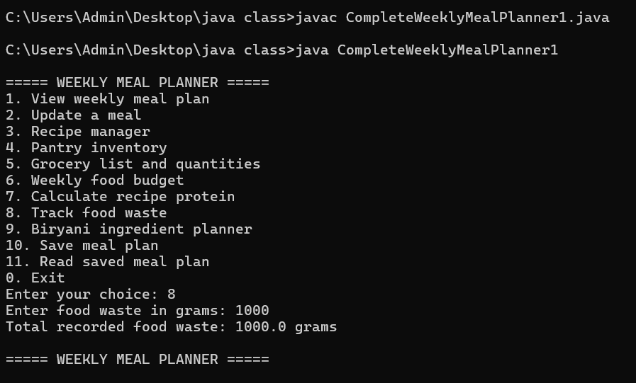
APPLICATION EVIDENCE
Project Screenshot
Console output: Weekly Meal Planner menu and food-waste tracking

Slide 12
PROJECT REPOSITORY
Explore the code.
Weekly Meal Planner & Grocery Generator
GH
https://github.com/meghana200712/KLHB-FED-26-15-1-Weekly-Meal-Planner-Grocery-Generator
CODE
Click the repository link to view the source code and project files.
BUILD
SHARE
12 / 12

